Slide 1
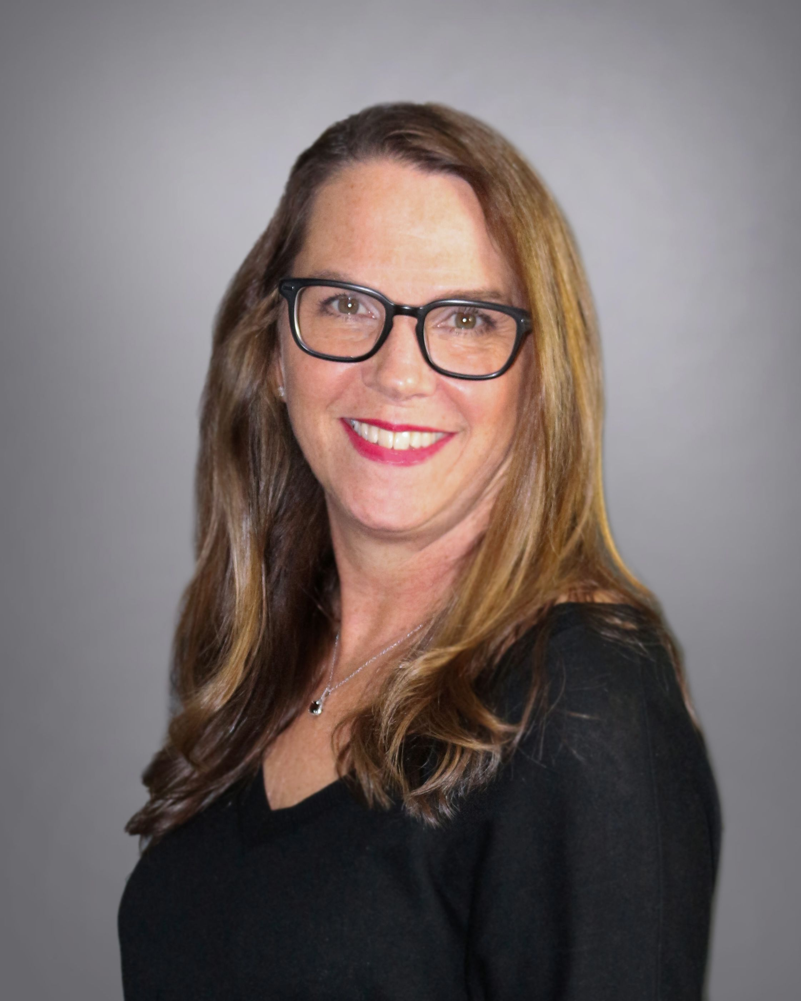
Document Your Quality Journey
Presented by: Jennifer Svoboda, BSW, MHA
Arete Living

Slide 2
A little about me…
Started as a Social Worker in skilled nursing and memory care 28 years ago
Moved over to Assisted Living 14 years ago
Wrote a winning Bronze application 8 years ago
Became a Silver Examiner 7 years ago
Began helping with application writing around the same time
Education
BA Social Work
Graduate Certificate Gerontology
MA Health Administration

Slide 3
Learning Objectives for Today
Why do this and what is Baldrige?
What does a Quality Journey mean?
Overview of AHCA/NCAL Quality Awards
Bronze – Set the stage
Silver – Tell your story
Gold – Show your story
Technical versus effective application writing i.e., getting your message across and meeting requirements
Matching prose with data
Tell your stories

Slide 4
Why do we do this?
Process Improvement
Root cause analysis
Data management
Building an effective team culture
Identification of areas of opportunity across the organization
A reminder of what already makes you great

Slide 7
Baldrige Performance Excellence Program
Simple Purpose
How is your organization doing?
Is your organization doing as well as it could?
How do you know?
What/how should your organization improve or change?
Promotes a Systems Perspective
Process oriented; Results focused
Emphasizes linkages and improvement
Adaptable to any organization
Notes:
organizational agility, innovation, and transformation
risk management and supply-chain resilience
societal contributions and environmental sustainability
the changing nature of work and workforce needs
diversity, equity, and inclusion

Slide 8
How Can the Baldrige Criteria Help You?
as the basis for internal performance programs,
to determine the quality of suppliers,
to manage culture shifts and engage the workforce,
to help manage your ‘brand’ and reputation,
to validate your voice-of-the-customer strategies,
to guide organizational learning and the improvement of performance outcomes,
to remain agile in turbulent and changing times, and
to ensure the efficiency and effectiveness of resources.

Slide 9
Defining a Quality Journey
It starts with you and the leaders and team
What do you and the team do each day that leads to better quality care?
What systems do you have in place to ensure you are ‘seeing’ issues?
How do you correct broken systems?
How do you communicate with the staff to ensure everyone knows their role?
How do you handle feedback from residents, families, the greater community and staff?

Slide 10
Overview – Bronze – Setting the Stage
The Bronze Award level provides applicants with the tools and resources they need for continuous im​provement in quality care. Through the Bronze criteria, based on the Baldrige Excellence Framework, applicants will assess their organization’s mission, vision, and key factors that lead to success.

Slide 11
Overview – Silver – Tell Your Story
At the Silver Award level, applicants continue to learn and develop effective approaches that help improve performance and health care outcomes. The Silver criteria, based on the Baldrige Excellence Framework, provide applicants with a thorough assessment of how their organization works, its effectiveness, and tools for improvement in their approaches.

Slide 12
Overview – Gold – Show Your Story
The final step in the AHCA/NCAL National Quality Award Program is the Gold – Excellence in Quality Award. Recipients of the Gold Award are considered the best of the best in the profession.
​At the Gold Award level, applicants must show superior performance in areas of the criteria including leadership, strategic planning, and customer and staff satisfaction. By completing the Gold level criteria, organizations take their quality journey to a higher level through the valuable feedback received in the application process and thereby reaching organizational goals. Gold applicants address the Baldrige Excellence Framework in its entirety.

Slide 13
Quality Award Program

Slide 14
Technical versus effective application writing i.e., getting your message across and meeting requirements
Read through the application
1
Separate the questions
2
Outline an answer to each
3
Fill in the details
4
Put it all together
5

Slide 15
Some Examples…

Slide 16
Separate the Questions
P1.a.1
What are the main health care service offerings?
What is the relative importance of each to your organizational success?
P1.a.2
What is your organization’s mission/vision statement (verbatim)?
What are the specific methods used to communicate it across your organization?

Slide 17
Outline each answer
What are the main health care service offerings?
Skilled Nursing Care
Assistance with ADL’s
In House Therapy
Medication assistance
Engaged activity/life enrichment programing
What is the relative importance of each to your organizational success?
Healthy, satisfied residents with needs met
Providing nursing and rehabilitative therapy services Resident engagement
Financial success
What is your organization’s mission/vision statement (verbatim)?
To enhance the lives of everyone we serve
What are the specific methods used to communicate it across your organization?
Postings throughout the community
Daily stand-up meeting
During our move in process
Monthly all-staff meetings
Posted on all community websites
Discussed at all company-wide meetings
Regional calls

Slide 18
The Result for SNF
P1.a.1
The main health care service offerings at ABC are skilled nursing and long-term care nursing
The relative importance of each service is demonstrated by the revenue: The Long-Term Care (LTC) Nursing service brings 64% of the revenue compared to 36% for the Skilled Nursing Unit (STC).
P1.a.2
ABC's Mission Statement is to "Enhance the Life of Every Person We Serve."
The specific methods we use to communicate our Mission is through postings throughout the community, discussing in our daily stand-up meeting, during our move in process and at our monthly all-staff meetings. Our home office posts the mission statement on all community websites, discusses at all company-wide meetings and on regional calls where we talk about how we are meeting our mission by giving examples of how team members exemplify it in each of our communities.
TIP: Use the question in the answer!

Slide 19
The Result for ALF
TIP: Use the question in the answer!
P1.a.1
At ABC Assisted Living, our Main Healthcare Service Offerings are assistance with ADL’s, laundry services, light housekeeping, skin integrity monitoring, medication assistance, and restaurant style dining. Our Life Enrichment Director has programs that keep our residents connected to the greater community and provides a full calendar with a variety of programming to keep residents entertained.
These Offerings are important to our success because when our residents’ needs are being met and activity programming is tailored to the residents’ interests. Because of this, residents are more likely to stay at our community which leads to not only quality care and satisfaction but financial success.
P1.a.2
ABC's Mission Statement is to "Enhance the Life of Every Person We Serve."
The specific methods we use to communicate our Mission is through postings throughout the community, discussing in our daily stand-up meeting, during our move in process and at our monthly all-staff meetings. Our home office posts the mission statement on all community websites, discusses at all company-wide meetings and on regional calls where we talk about how we are meeting our mission by giving examples of how team members exemplify it in each of our communities.

Slide 20
Let’s Practice

Slide 21
P.2.c.2 2. What one HEALTH CARE RESULT did your organization improve by applying the KEY elements of your PERFORMANCE improvement system? The RESULT should be clearly clinical in nature, not merely a PROCESS RESULT that impacts a HEALTH CARE RESULT. Using the key steps and/or tools of your PERFORMANCE improvement system, describe the PROCESS by which this RESULT was improved, including what specific changes were made. Include data illustrating the improvement. ID/DD residential services providers only: Given the largely non-clinical nature of services provided, these centers may choose to report on improvement of a non- clinical resident-related RESULT in response to these criteria.

Slide 22
P.2.c.2 2. What one HEALTH CARE RESULT did your organization improve by applying the KEY elements of your PERFORMANCE improvement system? The RESULT should be clearly clinical in nature, not merely a PROCESS RESULT that impacts a HEALTH CARE RESULT. Using the key steps and/or tools of your PERFORMANCE improvement system, describe the PROCESS by which this RESULT was improved, including what specific changes were made. Include data illustrating the improvement. ID/DD residential services providers only: Given the largely non-clinical nature of services provided, these centers may choose to report on improvement of a non- clinical resident-related RESULT in response to these criteria.
P.2.c.2.2 Our senior leaders assessed our long-term residents and their quality of life in ADL ability. In Q1 of 2020, our facility saw a rise of ADL decline due to the pandemic and loss of group activities. The QAPI committee initiated a plan to focus and monitor ADL mobility in our Long-Term residents. We first reviewed our residents needs, restorative aide program and policies, and looked for ways to collaborate to increase ADL ability. We implemented a monthly Long-Term Resident meeting to totally scrub through the needs of our Long-Term population, implemented restorative programs and creative activities. This took diligent education and monitoring of staff and Senior Leaders for documentation had to be accurate and reflective of results. After several months of evaluating the facilities Long Term ADL ability, we saw a decrease in dependence and an increase in independence!
The Goal of the facility is to be under 15% for Long Term residents for worsened ADL ability. The QAPI committee and Senior Leaders have been evaluating the score and outcomes monthly and will continue to monitor going forward to ensure compliance, resident satisfaction with care, and our mission statement is fulfilled.
1/1/2023-3/31/2023 (Q1) | Facility Score: 17.0% | State Score: 18.7 % | National Score: 17.1%
4/1/2023-6/30/2023 (Q2) | Facility Score: 16.3% | State Score: 18.7% | National Score: 17.1%
7/1/2023-9/30/2023 (Q3) | Facility Score: 14.7% | State Score: 18.7% | National Score: 17.1%
10/1/2023-12/31/2023 (Q4) | Facility Score: 12.9% | State Score: 18.7% | National Score: 17.1%

Slide 23
Silver Categories aka Baldridge Criteria
Leadership
Strategy
Customers
Measurement, Analysis, and Knowledge Management
Workforce
Operations
Results
Notes:
Describe ‘how’ a process works
Approach
Deployment
Learning
Integration
Results:
Trends Levels Comparisons

Slide 24
1.1 Senior Leadership (65 points)
Basic Level
1.1a HOW do your SENIOR LEADERS lead the organization?
Overall Level
1.1b HOW do SENIOR LEADERS deploy the MISSION, VISION and VALUES through the organization (i.e., WORKFORCE, PATIENTS/RESIDENTS, and other KEY CUSTOMERS)?
1.1e LEARNING (Evaluation and Improvement): HOW do you evaluate and improve the approaches SENIOR LEADERS have in place to respond to Item 1.1 (Senior Leadership)?

Slide 25
1.1 Senior Leadership (65 points)
Basic Level
1.1a HOW do your SENIOR LEADERS lead the organization?
Overall Level
1.1b HOW do SENIOR LEADERS deploy the MISSION, VISION and VALUES through the organization (i.e., WORKFORCE, PATIENTS/RESIDENTS, and other KEY CUSTOMERS)?
1.1e LEARNING (Evaluation and Improvement): HOW do you evaluate and improve the approaches SENIOR LEADERS have in place to respond to Item 1.1 (Senior Leadership)?
1.1a Our Senior Leaders, which consist of our Administrator and department heads, lead our organization by providing our staff with quality training, creating a positive work environment, teaching our Core Values and holding staff accountable for meeting expectations and goals.
1.1b Senior Leaders deploy our vision and values through the organization by providing new employee handbooks to all new hires, an all-day new hire orientation including one on one time with each department head as well as videos introducing our Core Values and Mission Statement, monthly All-Staff meetings, postings which display our Core Values throughout the building and community newsletters that are received by both residents and families. Our website includes our Mission on the landing page for our future residents and their families as well as…
1.1e To evaluate and improve the approaches Senior Leaders have in place to celebrate staff success and value, we take a close look at our annual employee satisfaction survey results and the feedback provided by our staff throughout the year. Based on those results, our management team comes together to establish a plan to improve on any less than desirable results and discuss new ways to keep our staff happy and engaged. For example…. By using the Quality Improvement Process as detailed above in section P.2.c(1), we were able to identify employees wanted a more robust recognition program for those who worked all shifts scheduled. We created an incentive and rewards program through our scheduling system for meeting goals. We continued to gather feedback during our All-Staff meetings, in-person conversations and our suggestion box and have found that staff are extremely happy with the plan, and we have increased workplace satisfaction at the same time.

Slide 26
Where can you find the data?
Category 7

Slide 27
Data Collection and Category 7: Results
The Results category asks about your organization’s PERFORMANCE in all KEY areas – health care and PROCESS RESULTS; customer RESULTS; workforce RESULTS; leadership and GOVERNANCE RESULTS; and financial, market, and strategy RESULTS. This category also asks about your organization’s PERFORMANCE levels relative to other organizations.

Slide 28
Required Results
7.1
30-day Readmission or Hospitalization Rates
Antipsychotic Rates
Five-Star Quality Measure Rating*
7.2
Overall Customer Satisfaction
or
Customer Willingness to Recommend
or
CoreQ
7.3
Staff Turnover or Staff Retention (choose one)
Five-Star – Staffing Measure Rating – Overall*
7.4
Five-Star Overall Rating*
Five-Star Survey Measure Rating*
7.5
Financial RESULTS and
•Marketplace RESULTS and
•Strategy implementation RESULTS and
include appropriate COMPARATIVE DATA

Slide 29
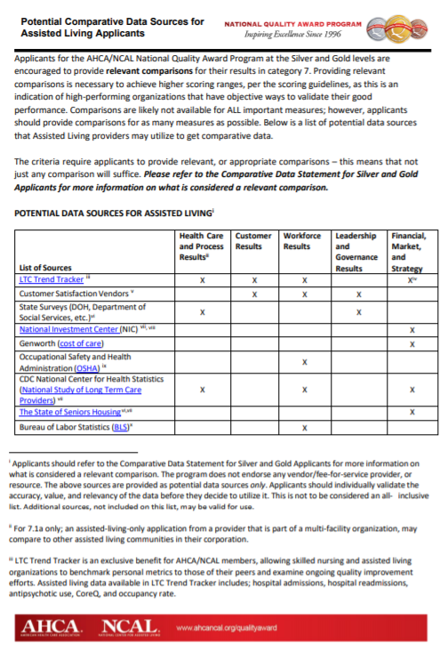
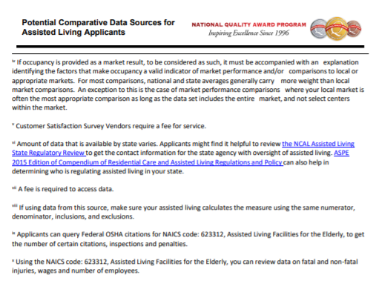
https://www.ahcancal.org/Quality/National-Quality-Award-Program/MemberOnlyDocs/Potential%20AL%20Data%20Sources%20Final.pdf

Slide 30
Long Term Care Trend Tracker AL Data
Turnover, Off Label Psychotropics, Return to Hospital
Long Term Care
Trend Tracker SNF Data
Government data collected by the Centers for Medicare and Medicaid Services (CMS) on skilled nursing centers
Notes:
​What is LTC Trend Tracker? ​LTC Trend Tracker is a web-based, data collection and benchmarking tool owned by the American Health Care Association/National Center for Assisted Living (AHCA/NCAL) that enables long term and post-acute care providers to access key information that can help their organization succeed. Why should I participate in LTC Trend Tracker? ​As an AHCA member, LTC Trend Tracker is an exclusive member benefit, included as part of your membership dues. You will have a unique opportunity to compare an expansive list of organizational characteristics (e.g., staffing levels, resident characteristics, survey findings, revenue and cost, Medicare patient days, and quality measures) to your peers – all in one central place. This information can be supplied to your administrators, clinicians, and other staff to improve your performance in operations, quality, and resident care.

Slide 31
CoreQ for SNF… What is it?
SNCC Long-Stay Residents
In recommending this facility to your friends and family, how would you rate it overall?
Overall, how would you rate the staff?
How would you rate the care you receive?
SNCC Long-Stay Family
In recommending this facility to your friends and family, how would you rate it overall?
Overall, how would you rate the staff?
How would you rate the care your family member receives?
SNCC Short-Stay Discharge
In recommending this facility to your friends and family, how would you rate it overall?
Overall, how would you rate the staff?
How would you rate the care you receive?
How would you rate how well your discharge needs were met?

Slide 32
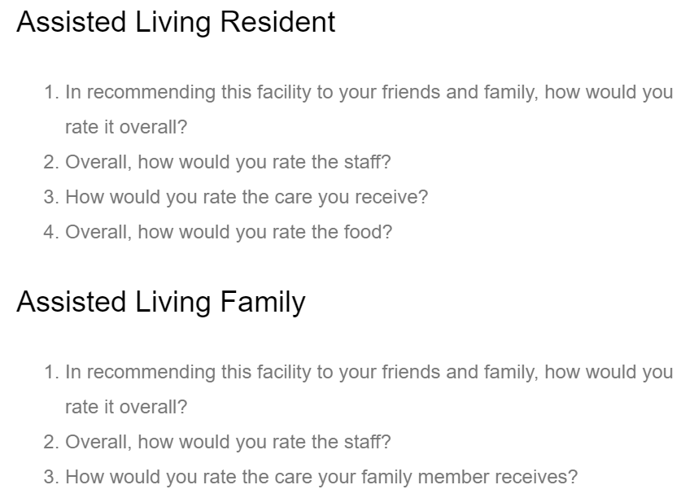
CoreQ for AL… What is it?
http://coreq.org/
Notes:
CoreQ is a set of five measures for skilled nursing care centers (SNCC) and assisted living (AL) communities to use to assess satisfaction among patients, residents, and their families developed by a team including, Nicholas Castle, Ph.D., the American Health Care Association/National Center for Assisted Living (AHCA/NCAL), and providers with input from customer satisfaction vendors and residents. The measures capture short-stay and long-stay resident and family data for SNCCs, and resident and family data for ALs. Based on a core set of customer satisfaction questions to allow consistent measurement across long term and post-acute care settings, CoreQ has been independently tested as valid and reliable. The National Quality Forum (NQF) endorsed all five CoreQ measures.

Slide 33
Satisfaction Surveys
Pinnacle
MyInnerview
CoreQ
Reputation.com
Activated Insights
Align
Care Analytics
NRC Health
Senior Living Alliance
Your Solutions
And Many More!
With CoreQ Questions

Slide 34
Category 7.5 Financial, Market, and Strategy Results
Strategy Implementation – This should be a separate result that shows the measures or indicators of your strategic objectives and action plan achievement from the strategic objectives and goals you report in 2.1 and action plan performance you report in 2.2. This result must show progress toward achieving the goals or future levels of performance and must show evidence of your assessment of achieving the desired future targets of performance. Some organizations use a Green-Yellow-Red scale to indicate the extent to which the objectives, goals and action plans are on track, moderately behind schedule, or in danger of failing.

Slide 35
Key Strategic Objective | Performance Measure | Data Source | Reviewed by | Frequency
People | Customer Satisfaction (Patient/Resident and Family) and Willingness to Recommend (Fig. 7.2-1 and Fig. 7.2-2) Staff Turnover (Fig. 7.3-1) Employee Satisfaction (Fig. 7.2-3) | Abaqis Power BI, LTC Trend Tracker OnShift Audit | QAPI committee Fun Committee QAPI Committee | M, A M, A M
Quality | UTI Infections, Falls, Pressure Ulcers, Antipsychotic Rates (Fig. 7.1-5, Fig. 7.1-4, 7.1-6, Fig. 7.1-2) | CMS Casper and 5-star LTC Trend Tracker | QAPI committee | M, A
Reimbursement | PDPM rate for Medicare (Fig. 7.5-2) | Power BI | Administrator | M, A
Growth | Occupancy Rate (Fig. 7.5-1) | LTC Trend Tracker | Administrator & Senior Leaders | D, M, A
Continuum | 30 Day Re-admission Rate (Fig. 7.1-1) | Abaqis | QAPI committee | M, A
Payers | PPD revenue (Fig. 7.5-4) Out of Standard Accounts Receivable (Fig. 7.5-3) | Power BI | Administrator QAPI committee | M, A
Frequency: D=Daily; M=Monthly; A=Annually
Fig. 4.1 Key performance measures
Example
Eugene Rehab, Silver Application 2020

Slide 36
Good
Goal Zone

Slide 37
Tell us your story

Slide 38
Key Dates 2023-2024
June 27
2024 Quality Award Program year begins and applications available
August
Intent to Apply (ITA) opens and Examiner applications available
October 3
​2023 Quality Award Ceremony and Celebration at the AHCA/NCAL Convention in Denver, CO
November 16
ITA deadline
January 25, 2024
Application Deadline
Summer 2024
Bronze, Silver, and Gold Award Notifications

Slide 39
Resources
Quality Award Website: https://www.ahcancal.org/Quality/National-Quality-Award-Program
Quality Award Questions: qualityaward@ahca.org
Long Term Care Trend Tracker Website: https://www.ahcancal.org/Data-and-Research/LTC-Trend-Tracker/Pages/default.aspx
Jennifer Svoboda: jsvoboda@areteliving.com

